Slide 1

Introduction to Machine Learning Topic 6 – Artificial Neural Networks (HOML Ch. 10)
Master in Quantitative Economic Analysis MQuEA
Javier Bas
Universidad Autónoma de Madrid
2022/2023

Slide 2
Outline
Introduction
The perceptron
The multilayer perceptron (MLP) and backpropagation
MLP for regression
MLP for classification
Practice:
Building an Image Classifier
Building a regression MLP
More complex NN
Saving and restoring
Fine-tuning NN hyperparameters
Number of hidden layers
Number of Neurons per hidden layer
Learning rate, batch size, and other hyperparameters
Master in Quantitative Economic Analysis MQuEA
Universidad Autónoma de Madrid

Slide 3
Introduction
Artificial Neural Networks (ANN, or NN, for short) are versatile, powerful, and scalable.
There are ideal for highly complex problems such as classifying millions of images, speech recognition, video recommendations, or complex games such as Go.
However, there exist the temptation of applying a NN to every problem.
Most of the times, our data is tabular, and our problems are not especially complex nor present features with highly non-linear relationships. If that’s the case, an NN will perform worse other ‘simpler’ methods.
Master in Quantitative Economic Analysis MQuEA
Universidad Autónoma de Madrid

Slide 4
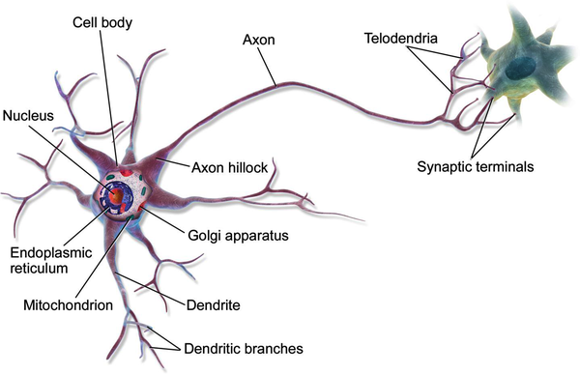
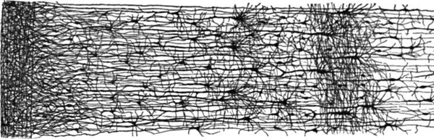
Introduction
Ramón y Cajal, you badass!!
Multiple layers in a biolotgical neural network (human cortex)
Biological neuron
Master in Quantitative Economic Analysis MQuEA
Universidad Autónoma de Madrid

Slide 5
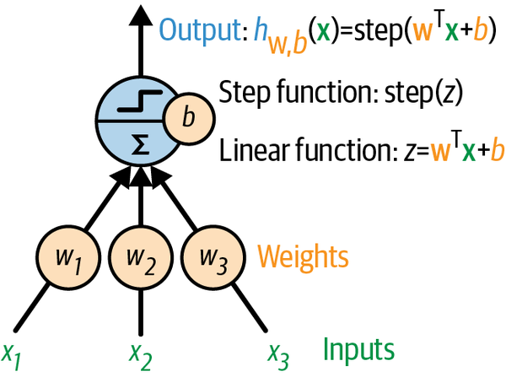
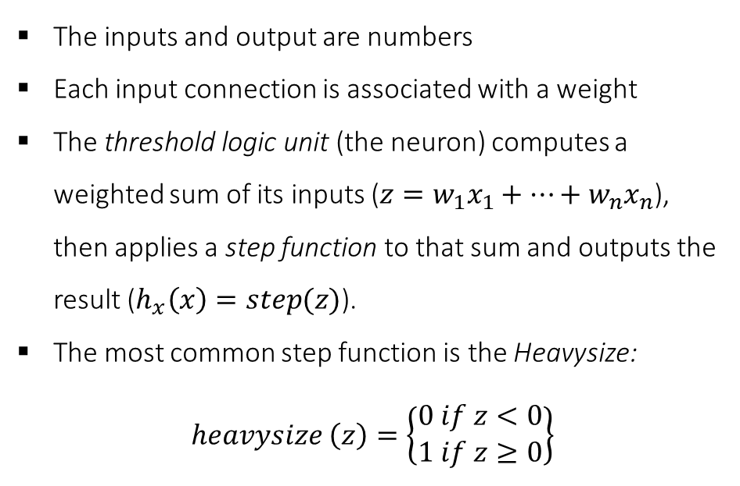
The perceptron
The inputs and output are numbers
Each input connection is associated with a weight
The threshold logic unit (the neuron) computes a weighted sum of its inputs ($z=w_{1}x_{1}+…+w_{n}x_{n}$), then applies a step function to that sum and outputs the result ($h_{x}\left(x\right)=step(z)$).
The most common step function is the Heavysize:
$$heavysize \left(z\right)=\left\{\begin{aligned}0 if z<0 \\ 1 if z≥0\end{aligned}\right\}$$
The Perceptron, invented by Frank Rosenbalt in 1957
Master in Quantitative Economic Analysis MQuEA
Universidad Autónoma de Madrid

Slide 6
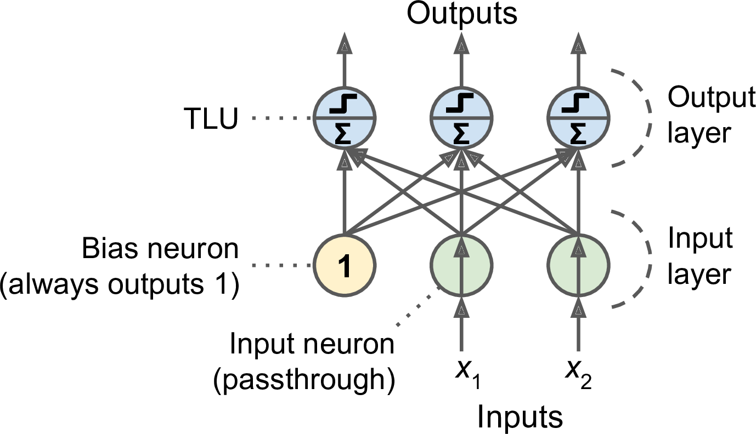
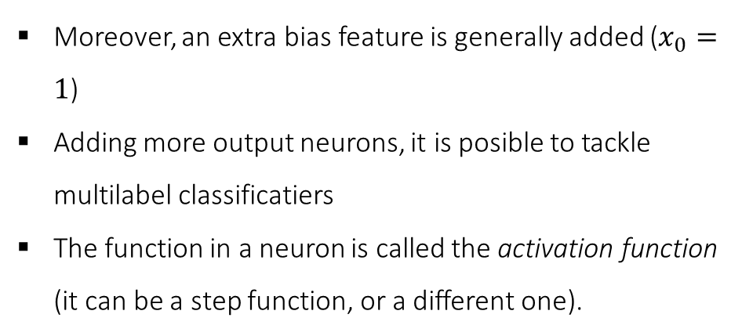
The perceptron
Moreover, an extra bias feature is generally added ($x_{0}=1$)
Adding more output neurons, it is posible to tackle multilabel classificatiers
The function in a neuron is called the activation function (it can be a step function, or a different one).
Master in Quantitative Economic Analysis MQuEA
Universidad Autónoma de Madrid

Slide 7
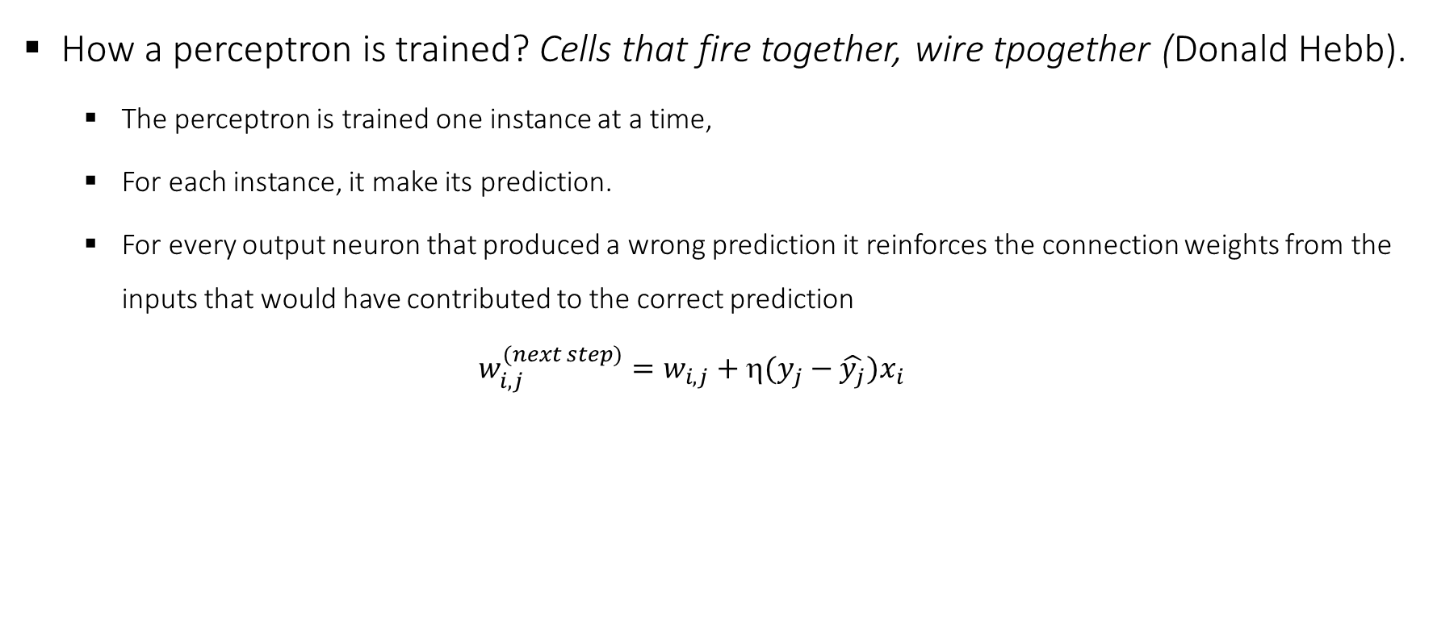
The perceptron
How a perceptron is trained? Cells that fire together, wire tpogether (Donald Hebb).
The perceptron is trained one instance at a time,
For each instance, it make its prediction.
For every output neuron that produced a wrong prediction it reinforces the connection weights from the inputs that would have contributed to the correct prediction
$$w_{i,j}^{(next step)}=w_{i,j}+η(y_{j}−\hat{y_{j}})x_{i}$$
Master in Quantitative Economic Analysis MQuEA
Universidad Autónoma de Madrid

Slide 8
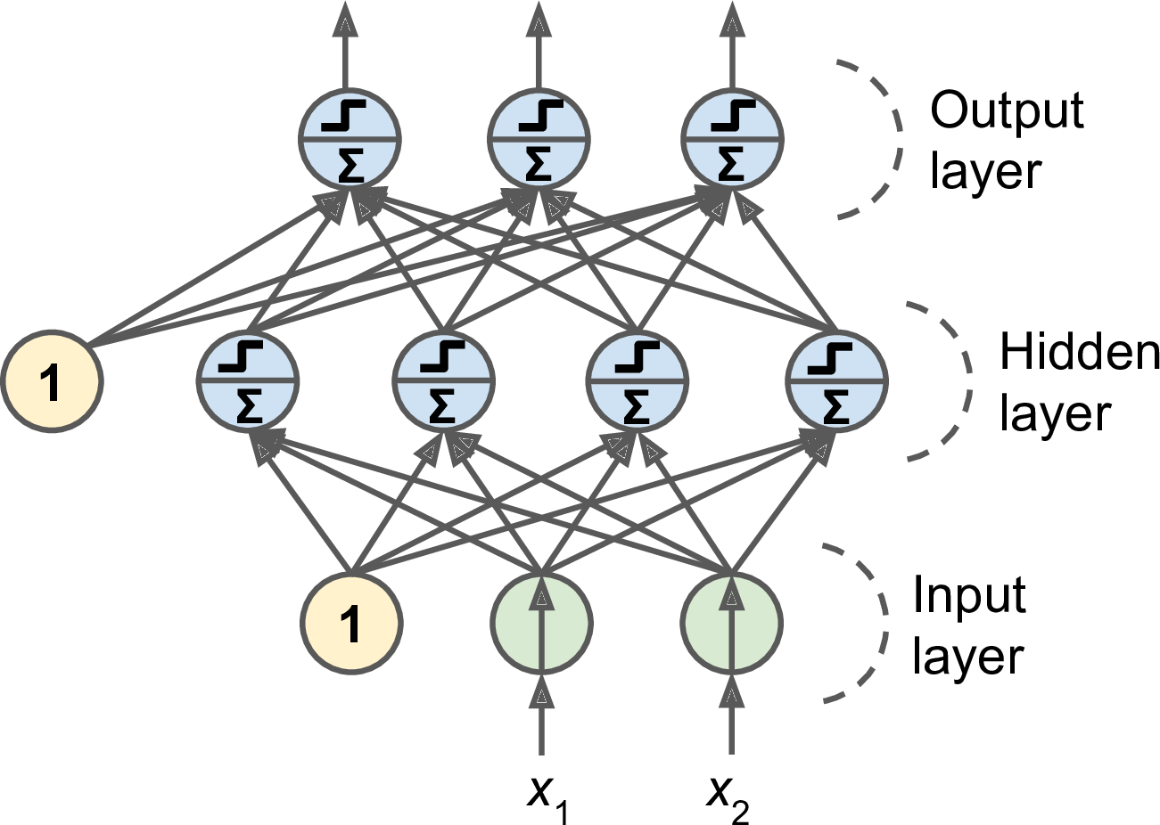
The multilayer perceptron (MLP) and Backpropagation
The perceptron has certain limits, which can be easily overcome by stacking multiple perceptron in the so-called Multilayer Perceptron
The MLP is composed of one input layer, one or more layers of threshold logic units, and one final layer called the output layer
The layers close to the input one are usually called lower layers, while the layers close to the output one, upper layers
Every layer except the output layer includes a bias and is fully connected to the next layer
Master in Quantitative Economic Analysis MQuEA
Universidad Autónoma de Madrid

Slide 9
The multilayer perceptron (MLP) and Backpropagation
A MLP is trained using Backpropagation, a technique that finds out how each connection weight computed and bias should be tweaked to reduce error. Concretelly:
It handles one mini-batch at a time and go through the full training set multiple times. Each pass is called an epoch.
Each mini-batch enters the network through the input layer. The algorithm computes the output of all the neurons in the first hidden layer, for every instance in the mini-batch. The result is passed on to the next layer to do the same, and so on until we get the output of the last layer. This is the forward pass.
Next, the algorithm measures the network’s output error using a loss function.
It computes how much each bias and weight contributed to the error. This is done analytically by applying the chain rule.
Then measures how much of these error contributions came from each connection in the layer below, working backward until it reaches the input layer.
The algorithm performs a gradient descent step to tweak all the connection weights in the network, using the computed error gradients.
Master in Quantitative Economic Analysis MQuEA
Universidad Autónoma de Madrid

Slide 10
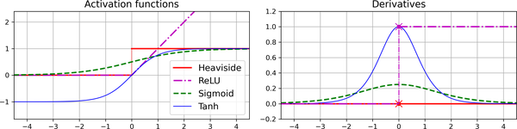
The multilayer perceptron (MLP) and Backpropagation
In order for this algorithm to work properly, the step function was replaced with the logistic function
The reason is that the step function contains only flag segments, so there is no gradient to work with. The logistic function has a well-defined nonzero derivative everywhere.
Two other wide used functions are the hyperbolic tangent function and the Rectified Linear Unit function (RELU)
Master in Quantitative Economic Analysis MQuEA
Universidad Autónoma de Madrid

Slide 11
MLP for regression
If we want to predict a single value (such as the price of a house) we only need a single output neuron
For multivariate regression, we need one output per output dimension
When building a MLP for regression we do not want to indicate any activation function for the output neurons, so they are free to output any range of values. If we need to guarantee that the output is positivbe, then we an use the RELU activation function (there is also a soft RELU called SELU
The loss function during training is typically the mean squared error. But if there are many outliers, the mean absolute error may be better. Or Huber Loss, which is a combination of both
Master in Quantitative Economic Analysis MQuEA
Universidad Autónoma de Madrid

Slide 12
MLP for classification
For a binary classification problem, we just need a single output neuron with the logistic activation function. The output will be between 0 and 1, and can be interpreted as the probability of the positive class
For multilabel classification (an instance pertaining to more than one class), we would need as many output neurons as positive classes, all using the logistic activation function (not all probabilities sum up to 1!!)
If each instance can belong only to a single class out of three or more possible classes, then we need one output neuron per class, and the softmax activation function for the whole output. Softmax ensures that all estimated probabilities are between 0 and 1, nd that they add up to 1.
Regarding the loss function, since we are predicting probabilities, the cross-entropy loss (also called log loss) is a good choice.
Master in Quantitative Economic Analysis MQuEA
Universidad Autónoma de Madrid

Slide 13
MLP for regression/classification
Hyperparameter | Typical value
# input neurons | One per input feature (e.g 28x28 =784 for MNIST)
# hidden layers | Depends on the problem, typically 1 to 5
# neurons per hidden layer | Depends on the problem, typically 10 to 100
# output neurons | 1 per prediction dimension
Hidden activation | RELU (or SELU)
Output activation | None, or RELU/SELU
Loss function | MSE or MAE/Huber
Hyperparameter | Binary Classification | Multilabel binary classification | Multiclass classification
Input and hidden layers | Same as regression | Same as regression | Same as regression
# output neurons | 1 | 1 per label | 1 per class
Output activation | Logistic | Logistic | Softmax
Loss function | Cross entropy | Cross entropy | Cross entropy
Master in Quantitative Economic Analysis MQuEA
Universidad Autónoma de Madrid

Slide 14
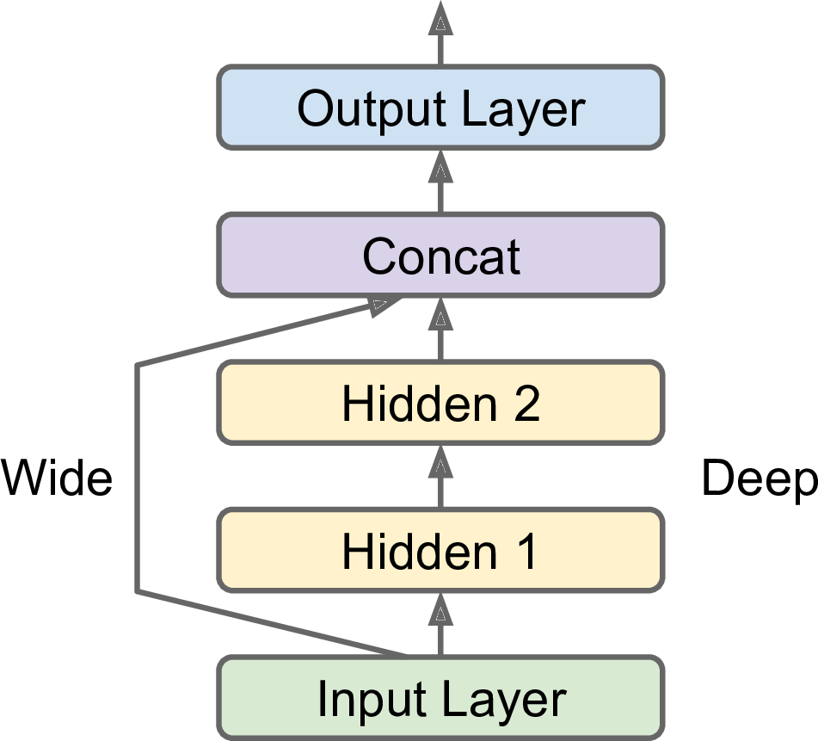
More complex NN
One example of a non-sequential neural network is the Wide & Deep neural network. It connects all or part of the inputs directly to the output layer
This architecture makes possible to learn both deep patterns and simple rules. In contrast a regular MLP forces all the data to flow through the full stack of layers; thus, simple patters may end up being distorted by the sequence of transformations
Master in Quantitative Economic Analysis MQuEA
Universidad Autónoma de Madrid

Slide 15
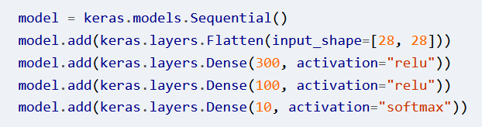
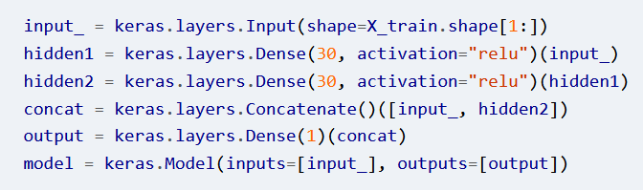
More complex NN
Sequential
Non-sequential
Master in Quantitative Economic Analysis MQuEA
Universidad Autónoma de Madrid

Slide 16
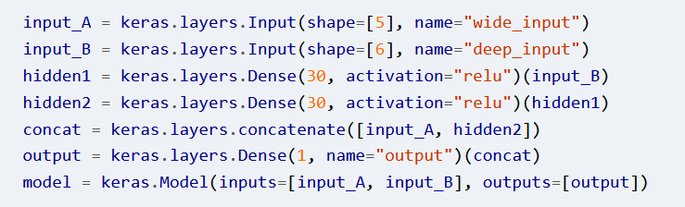
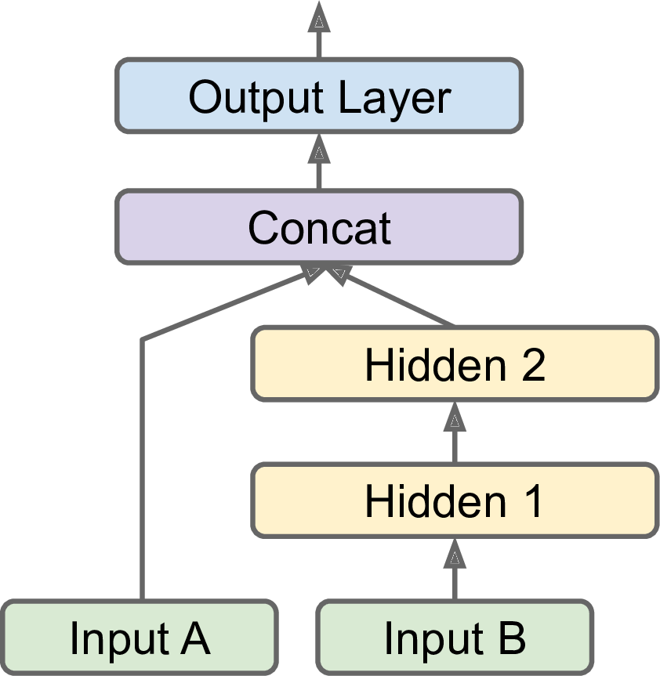
More complex NN
Master in Quantitative Economic Analysis MQuEA
Universidad Autónoma de Madrid

Slide 17
Saving and restoring
A whole model can be saved using the keras method .save(). This means saving its architecture and also all its parameters (weigths and biases of every layer, optimizer, and hyperparameter)
You can load this model later on (maybe in a different computer) and make predictions. This is done with load_model()
But what if the training takes several hours? In this case, we should salve the whole model at the end of the training, but also save checkpoints at regular intervals
This is perform using callbacks. The default option saves the model at the end of each epoch (but it can be customized)
Moreover, if we use a validation set, we can save the best model on the validation set so far
Master in Quantitative Economic Analysis MQuEA
Universidad Autónoma de Madrid

Slide 18
Fine-tuning NN hyperparameters
The flexibility of neural networks is also one of their main drawbacks; there are many hyperparameters to tweak (in addition to infinite possible architectures)
One options is try many combinations of hyperparameters, either using grid or random search. However, we can end up with hundreds of models, each of them needing hours to be trained
There are other techniques to explore the hyperparameter search space:
Hyperopt
Hyperas
Keras Tuner
Scikit-Optimize
Spearmint
Hyperband
Sklearn-Deep
Master in Quantitative Economic Analysis MQuEA
Universidad Autónoma de Madrid

Slide 19
Fine-tuning NN hyperparameters
Although hyperparameter tuning is an active area of research, it helps to have an idea of what values are reasonable for each hyperparameter.
Number of hidden layers: For MOST problems, you can begin with one single layer and obtain reasonable results. However, for complex problems, deep networks have a much higher parameter efficiency than shallow ones. This is, more layers with fewer neurons better capture higher complexities that one layer with lots of neurons. You can start with one and ramp up until you identify overfitting.
Number of neurons per hidden layer: It was common to use a pyramidal structure (more neurons in the lower layers), but this practice has been abandoned since the same number of neurons in each layer works just as well and avoids more additional hyperparameters to tune (the number of neurons in each deep layer). Again, you can start adding neurons until you identify overfitting.
transfer learning
Master in Quantitative Economic Analysis MQuEA
Universidad Autónoma de Madrid

Slide 20
Fine-tuning NN hyperparameters
Learning rate: Probably the mot important hyperparameter. Train the NN for a few hundred iterations starting with a very low learning rate and gradually increase it up to a very large value. Plot the loss as a function of the learning rate and you will find the optimal value. You can then reinitiate the model and train it again using that learning rate.
Batch size: Long story short, there is discussion about this, you can start with a large size and adjust progressively.
Number of iterations: No need to tweak this, use early stop. It is an argument passed to .fit() that makes the training to stop when no improvement has been obtained in the last X number of epochs.
Master in Quantitative Economic Analysis MQuEA
Universidad Autónoma de Madrid

